Slide 1


SPARK NEST
Crypto Alpha Generation
Hackathon Preliminary Round Presentation
PRESENTED BY:
PRESENTED TO:
Mohammed Mohammed Musleh
Balaena Quant & UM Hackathon Committee
Amro Adel Abdulrahman Rashed

Slide 2

The Challenge: Finding Alpha in On-Chain Data
OBJECTIVE:
DEVELOP AN ML MODEL USING ON-CHAIN DATA (CRYPTOQUANT, GLASSNODE, COINGLASS) TO CREATE A PROFITABLE CRYPTO TRADING STRATEGY.
CORE TASK: EXTRACT IMPLICIT INDICATORS FROM NOISY DATA FOR ALPHA GENERATION.
Key Requirements:
Data Interval: ≤ 1 Day (e.g., 1h, 4h)
Sources: Multi-platform on-chain data
Fees: Account for 0.06% trading fees
Testing: Multi-year backtest, ≥ 1-year forward test
Success Metrics: SR ≥ 1.8, MDD ≥ -40%, Trade Freq. ≥ 3%

Slide 3


Our Solution:
Two-Pronged Approach:
Robust Backtesting Framework (MVP - COMPLETED): A flexible Python library providing the essential tools for strategy simulation and evaluation.
Innovative ML Alpha Strategy : Leveraging the framework to develop, test, and deploy a model focused on capturing implicit market patterns.

Slide 4
CORE MODULES DEVELOPED :
fetch_data.py: Automated data acquisition & merging from sources.
data_loader.py: Standardized data loading, cleaning, and validation.
portfolio.py: Realistic portfolio simulation (cash, positions, 0.06% fees).
backtester.py: Orchestrates the event-driven simulation loop.
performance.py: Calculates key metrics (Sharpe, MDD, PnL, Trades).
The Python Backtesting Framework
KEY FEATURES:
Modularity: Easily plug in different strategies (AbstractStrategy interface).
Realism: Accurate fee calculation, time-series handling.
Extensibility: Designed for adding new data sources, strategies, and metrics.

Slide 5

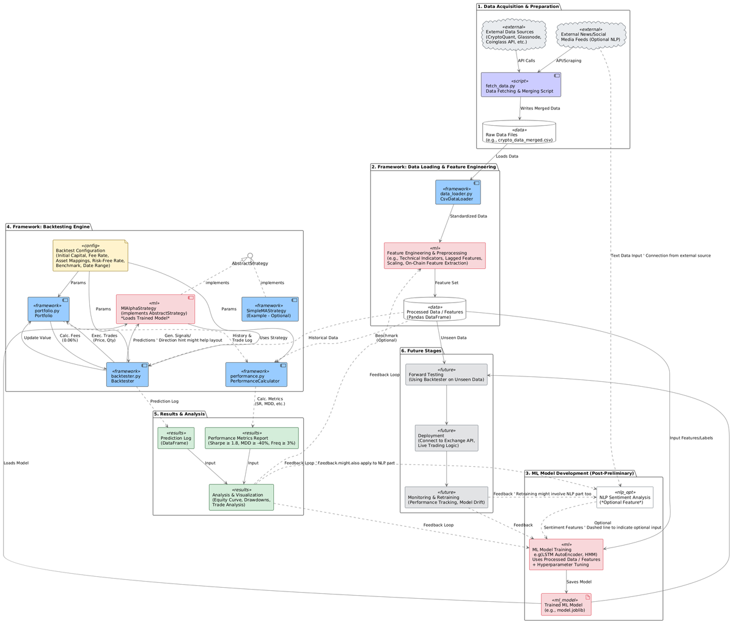
System Architecture
Data Pipeline: Fetch -> Load -> Feature Engineering (ML Focus Here).
ML Development (Offline): Train Model (LSTM Autoencoder planned) -> Save Model Artifact. Optional NLP path shown.
Backtesting Engine : Config -> Backtester uses Loaded Model via MLStrategy -> Portfolio simulates trades (with fees) -> Performance Calculator evaluates.
Results & Feedback: Metrics Report -> Analysis -> Loop back to refine Features/Model.
Future: Forward Test -> Deploy -> Monitor.

Slide 6

Live Demo
now we are going to show a live demonistration of how our backtesting library is evaluating the Strategies using sample strategy

Slide 7

Planned ML Strategy: Capturing Market Regimes/Anomalies
Model Candidates: Two approaches:
Hidden Markov Models (HMMs): Models unobserved market states using on-chain data. Provides interpretable states like Bull, Bear, and Volatile.
LSTM Autoencoders (LSTM AE): Captures complex time dependencies and identifies anomalies when market behavior deviates from normal patterns.
Feature Focus: Key on-chain metrics (SOPR, Exchange Flows, OI, Active Addresses) and derived features (momentum, ratios, lagged values). Optional: NLP Sentiment score.
Signal Generation Logic:
HMM: Trade based on market state transitions or probabilities.
LSTM AE: Trade based on anomaly score changes, with careful interpretation.

Slide 8
Next Steps
FEATURE ENGINEERING IMPLEMENTATION
FINAL MODEL SELECTION & TRAINING:
Translate key on-chain concepts (SOPR dynamics, flow ratios, OI momentum) into concrete numerical features for the model.
Compare between HMM or LSTM AE and Train the chosen model on the historical feature set (multi-year data). Tune hyperparameters.
ML STRATEGY INTEGRATION
POTENTIAL ADDITIONS (TIME PERMITTING)
Implement the chosen model within MlAlphaStrategy, including the specific logic to translate model output (states/anomaly scores) into BUY/SELL/HOLD signals respecting the ≥3% frequency target.
Integrate sentiment scores from crypto news and social media into the primary ML model to capture short-term sentiment shifts.
Combine model outputs with simpler classifiers or rule-based systems for signal confirmation.
Validate the tuned model on over a year of unseen data before deployment.

Slide 9
Thank You
Questions?
Team: SparkNest

